Slide 1
Sentiment Analysis for Financial News
InfoTrie Financial Solutions Pte Ltd
News Analytics, Big Data and Financial Engineering
www.infotrie.com
@infotrie
www.finsents.com
@finsents

Slide 2
Content
What Is Sentiment Analysis
Why Would We Want to Do This
Process of Real-time Sentiment Analysis
Practical Application: Real-time Analytics in Trading Business
Professional Product for Sentiment Analysis

Slide 3
What is sentiment analysis
Sentiment Analysis is the means of applying natural language processing methods and determining subjective information in source text.
In text analysis, sentiment is the attitude or opinion expressed towards something. Sentiment can be positive, negative or neutral.
Positive Neutral Negative

Slide 4
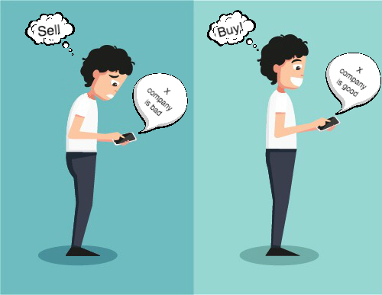
Why would we want to do this
Emotion and psychology
influence trading and
investment decisions,
causing people to behave in an
unpredictable or
irrational way.

Slide 5
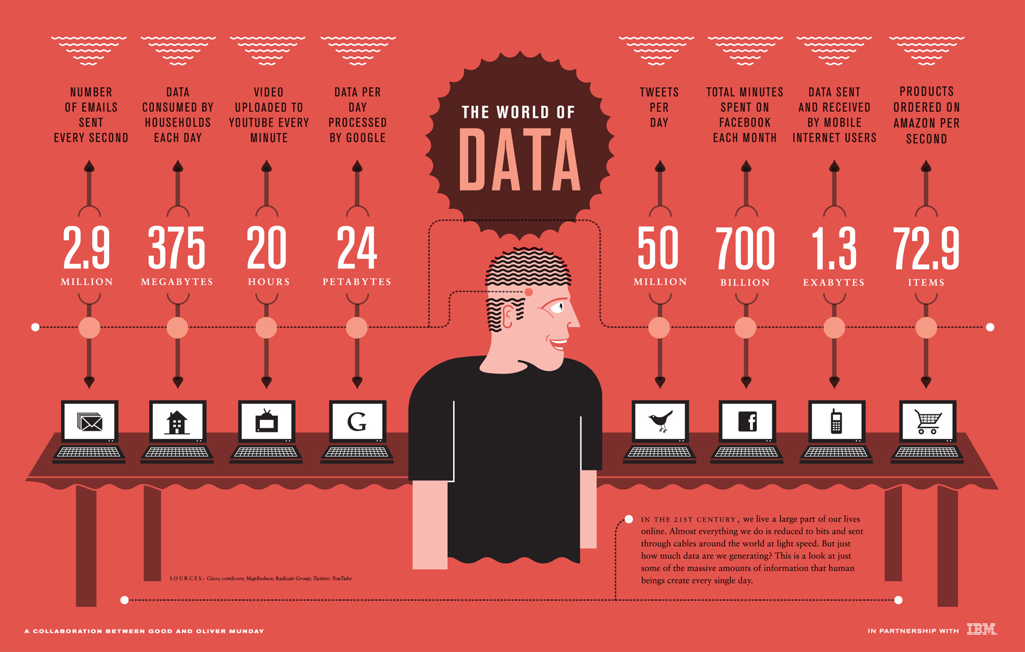
Why would we want to do this
Meanwhile, the glut of
data makes reading
everything an
impossible task.

Slide 6
Why would we want to do this
Extract more information
Automate the analysis of unstructured content
Limit the noise
Speed up the understanding
So we need
sentiment analysis to:

Slide 7
Process of real-time sentiment analysis
The process of real-time sentiment analysis can be roughly divided into the following four steps:
Topic Classification
Visualization
NER
Sentiment Score Process

Slide 8
Process of real-time sentiment analysis
Process of real-time sentiment analysis
Topic Classification
Visualization
NER
Sentiment Score Process
1. Topic Classification on Apache Spark
We consider five different news topics: Economics, Legal, Politics, Security, and Non.
Non topic consists of all other topics, such as Health, Technology, and Sports. Naive Bayes Algorithm from Apache Spark's MLlib is used to train and predict news topic.

Slide 9
Process of real-time sentiment analysis
Process of real-time sentiment analysis
Topic Classification
Visualization
NER
Sentiment Score Process
1. Topic Classification on Apache Spark
The step outlines:
Extract articles titles and contents
Tokenize the texts and remove non-alphabet characters and stop words
Split the articles into training and test set
Calculate tf-idf matrix on training set
Train Naive Bayes Algorithm with training set
Classify the test article and measure the result performance

Slide 10
Process of real-time sentiment analysis
NER
Visualization
Topic Classification
Sentiment Score Process
2. Named Entity Recognition (NER)
Normally, a reader need to know the following two questions from a piece of news:
What’s objective that the news is talking about? For example, Apple or Facebook?
In general, is it bad or good?

Slide 11
Process of real-time sentiment analysis
NER
Visualization
Topic Classification
Sentiment Score Process
2. Named Entity Recognition (NER)
The technology of Named Entity Recognition (NER) is for answering the first question: What’s objective that the news is talking about? For example, Apple or Facebook?
More specifically, quickly determining which item in the text maps to proper names, such as people or places.

Slide 12
Process of real-time sentiment analysis
NER
Visualization
Topic Classification
Sentiment Score Process
2. Named Entity Recognition (NER)
For InfoTrie, we need to go further to determine which company is involved in the news.
We decouple the task into two parts:
Use the popular community package like nltk and Stanford NER to narrow down the searching space.
Search for the company name using our own company synonym database.

Slide 13
Process of real-time sentiment analysis
NER
Visualization
Topic Classification
Sentiment Score Process
2. Named Entity Recognition (NER)
After NER process, the news will be documented under the identified company name for delivery or further analysis.
Sometimes, one news mentioned several companies. In this scenario, relevance measure is conducted. The relevance measure considers the location of a term in the text. For example, intuitively, one news may be more relevant to a company when the name of the company occurs in the title.

Slide 14
Process of real-time sentiment analysis
Process of real-time sentiment analysis
Visualization
Topic Classification
NER
Sentiment Score Process
3. Sentiment Score Process
Ordinary method:
To know whether a news is bad or good to a company, a common way is to search for the emotional states such as “angry,” “sad,” and “happy.” and count on the occurrence of these states.

Slide 15
Process of real-time sentiment analysis
Process of real-time sentiment analysis
Visualization
Topic Classification
NER
Sentiment Score Process
3. Sentiment Score Process
Our method:
In our case, we first collect a library of these emotional states specialized in financial community.
Next, we count on all the words that both in the library and text.
Then normalize the counting result for both positive and negative words to [0, 10], where score 0 means that all words are negative and score 10 means that all are positive.

Slide 16
Process of real-time sentiment analysis
Process of real-time sentiment analysis
Visualization
Topic Classification
NER
Sentiment Score Process
3. Sentiment Score Process
Advantages of our method:
These scores can be treated as a quantitative measure of sentiment that can be used to compare between companies and time.

Slide 17
Process of real-time sentiment analysis
Process of real-time sentiment analysis
Topic Classification
NER
Visualization
Sentiment Score Process
4. Visualization
Finally, both NER and sentiment scoring process are completed on the distributed computational clusters so that the analyzing result can be delivered and documented in real-time.

Slide 18
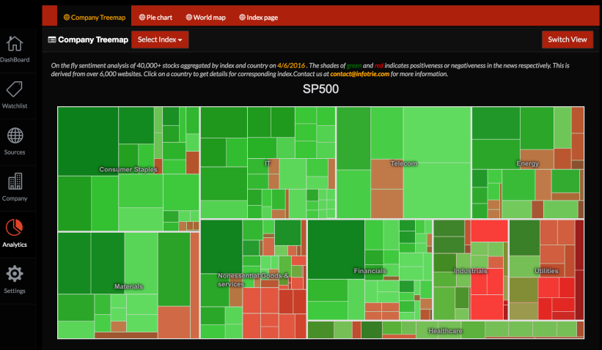
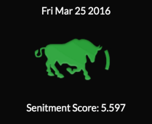
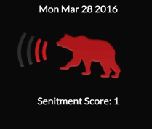
Process of real-time sentiment analysis
Process of real-time sentiment analysis
Topic Classification
NER
Visualization
Sentiment Score Process
4. Visualization
Very positive
Slightly positive
Very negative

Slide 19
Real-time analytics in trading business
Let’s see a practical application: Real-time analytics in trading business
Method
News
Economics data
Social Media
Quotes
Storm Topologies
Spark Streaming
Redis DB
Data Updates
Alerts
Real-time Analytics
Engine
Data Feed
Engine
Portal

Slide 20

Real-time analytics in trading business
Traders usually need to make mass of trading decisions based on multiple dimensions of information like news, financial analysis reports, real-time quotes and so on.
Data Feed Engine:

Slide 21
Real-time analytics in trading business
Real-time Analytics Engine:
With the help of the real-time analytics, the latency of the pre-decision process can be largely improved to the range from milliseconds to a few seconds once the business event has occurred.

Slide 22


Real-time analytics in trading business
Portal:
Last but not least, an alert will send to the trader and wait for his or her final trigger. Traders become the strategy creators and decision makers instead of data collectors and processors.

Slide 23

Professional Product for Sentiment Analysis
Since Sentiment Analysis is so important, is there any professional product which has following features to do it?
Advanced Technology
A Large Number of Users
Beautiful Interface
Ultra High Processing Speed
…

Slide 24
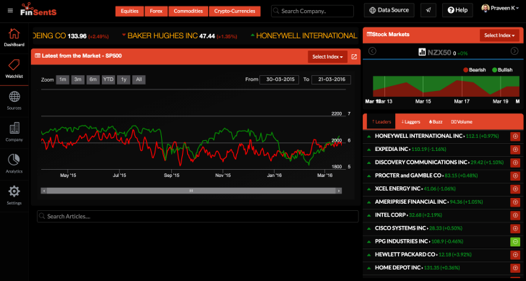
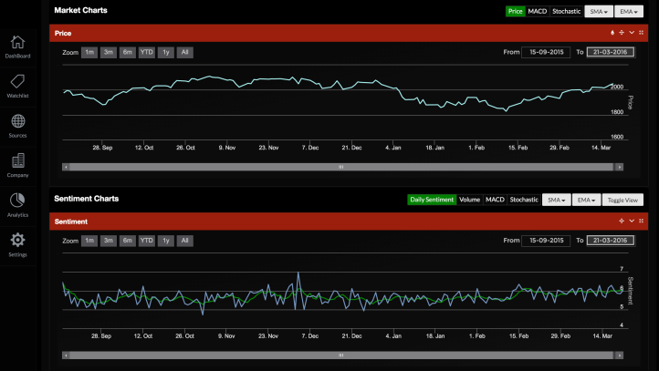
Professional Product for Sentiment Analysis
FinSentS is a cutting edge Sentiment Analysis and News Analytics engine.
FinSentS web Dashboard indexes in real-time, in a way similar to what Google or Bing does for business news, blogs and social media feed. It scans thousands of websites, blogs, and business news publications in real-time.

Slide 25
Professional Product for Sentiment Analysis
FinSentS
Premium and Extensive Sources
Multiple Languages
Customizable
Real-time and Low-latency
Scalable
Fault Tolerant
Six Advantages of
FinSentS

Slide 26
Professional Product for Sentiment Analysis
Take two minutes to register,
save two hours every day!
www.finsents.com

Slide 27



Contact us
CEO
Frederic Georjon
frederic.georjon@infotrie.com
Quantitative Analyst
Juan Cheng
cheng.juan@infotrie.com
CTO
Zhicheng Long
zhicheng.long@infotrie.com
Quantitative Analyst
Fernando Pratama
fernando.pratama@infotrie.com
Any comments, questions, suggestions or concerns please feel free to email: contact@infotrie.com.
And find us on social media to get real-time news!

Slide 28

Thank YOU!
www.infotrie.com
@infotrie
www.finsents.com
@finsents

